Slide 1
Evaluating different training methods on QA datasets
Rushabh Musthyala rm6416@nyu.edu
Charvi Gupta cg4177@nyu.edu

Slide 2
Executive Summary
Problem Statement - For different QA datasets, what is the best training strategy for a large language model with limited resources.
Solution Approach - fine tune a t5 model for a question-answering task on BioQA and GSM8k datasets and evaluate the performance and training metrics across different training strategies
Value - we aim to figure out what is the best method for completing such tasks keeping in mind various factors

Slide 3
Problem Motivation
As the field of DL grows, deciding how to train a model has become a difficult question to answer as hardware requirements continue to grow at a rapid rate
In particular, sequence-to-sequence language models are known for having a huge number of parameters and for taking a long time to train
There are also a plethora of GPUs and training techniques available
Deciding which one to use can be a difficult task

Slide 4
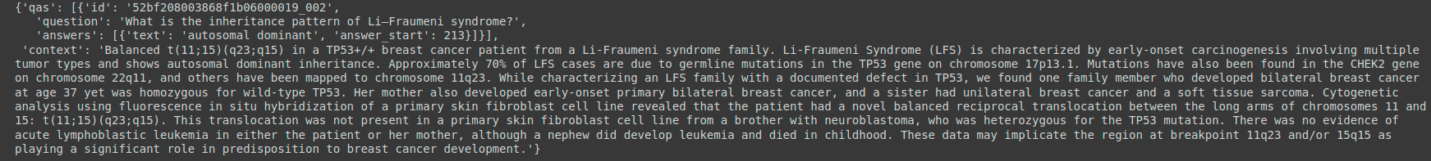
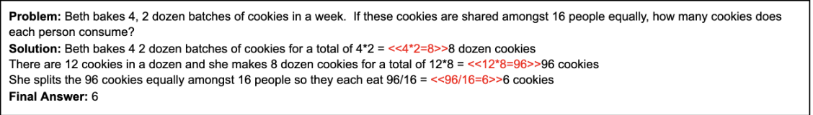
Background Work
T5 - Text to Text Transfer Transformer¹
Teacher Forcing technique - always need input sequence and corresponding output sequence
achieves SOTA results on many NLP benchmarks
flexible enough to be fine-tuned to a variety of important downstream tasks
Datasets -
BioQA - Biomedical QA dataset containing - a question (Q), human-annotated answers (A), and the relevant contexts (C)
GSM8k - Dataset of 8.5K high quality linguistically diverse grade school math word problems.
1 C. Raffel, N. Shazeer, A. Roberts, K. Lee, S. Narang, M. Matena, Y. Zhou, W. Li, and P. J. Liu, “Exploring the limits of transfer learning with a unified text-to-text transformer,” arXiv.org, 28-Jul-2020. [Online]. Available: https://arxiv.org/abs/1910.10683.
Notes:
We now describe the model and training framework we used for the project.
We use the T5 model
T5 is an encoder-decoder model pre-trained on a multi-task mixture (like summarization, translation, etc) of unsupervised and supervised tasks.
the differentiator that truly sets T5 apart from BERT-style models is that it does not output a label or a span of the input to the input sentence, but the output is a text string as well. This was a major reason why we chose this model.
This is a major advantage in interpreting the results. It has been trained on C4 common crawl dataset which is around 750GB in size.

Slide 5
Technical Challenges
Larger models take more time to train -
Simplified by increase batch size
Larger model (3 Billion parameters) could not fit into GPU memory
Faced OOM issues - did not work
Used variation of t5 model with 770M params
GSM8k - Expectation: Break down mathematical question into multiple reasoning steps in the answer
Simplified by predicting the final answer only

Slide 6
Approach
Basic Training Framework -
Define LightningModule - organize pytorch.nn.Module code into sections - initializations (loading a pretrained model), Train Loop (training_step), Validation Loop (validation_step), Test Loop (test_step), Optimizers and LR Schedulers (configure_optimizers)
Pretrained model t5-base : 222M params
Pretrained model t5-large: 770M params
Pretrained models t5-3b: 3B params (failed to load in memory)
Define datasets - BioQA data loader and GSM8k data loader
BioQA - Training size (~13000 instances, reduced to 2500 after preprocessing)
GSM8k - Training size (~7000 instances)
Define Trainer - allows mixing any LightningModule with any dataset
Train model
Record training data and validation performance
Notes:
we use Pytorch Lightning to abstract our base code and run it with different training configurations. In deep learning, there is a Boilerplate is code that is often reimplemented with little to no functional variation. Pytorch lightning has the functionality to make the code more readable because of abstraction and normalization of training functions. It is robust to errors, as it deals away with common issues that arise when training a pytorch based code on GPUs. It also makes the code hardware agnostic, meaning you can train it on CPUs, GPUs, TPUs, without requiring gradient accumulation or process rank management
With pytorch lightning, the boilerplate code remains the same, just The core ingredients have been organized by the LightningModule. It deals away with .cuda .to(device) calls
The training/validation loop code has been abstracted by the Trainer
Trainer object abstracts away all the engineering complexity needed for scale

Slide 7
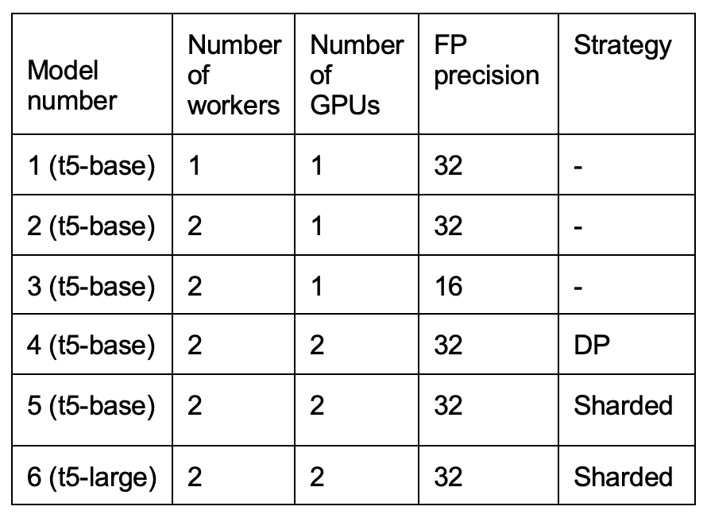
Approach
Experimental Training Framework -
We early stop at epoch 20 to trade computation resources per experiment for more experiments (12 experiments in total, 6 for each dataset)
Data Parallelism - Trainer Strategy - ddp
Each GPU gets visibility into a subset of the overall dataset.
Each process performs a full forward and backward pass in parallel.
The gradients are synced and averaged across all gpus.
Model Parallelism - Trainer Strategy - ddp_sharded
optimizer states, gradients and parameters are sharded across GPUs.

Slide 8
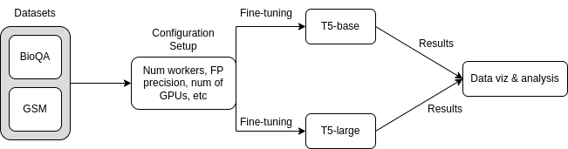
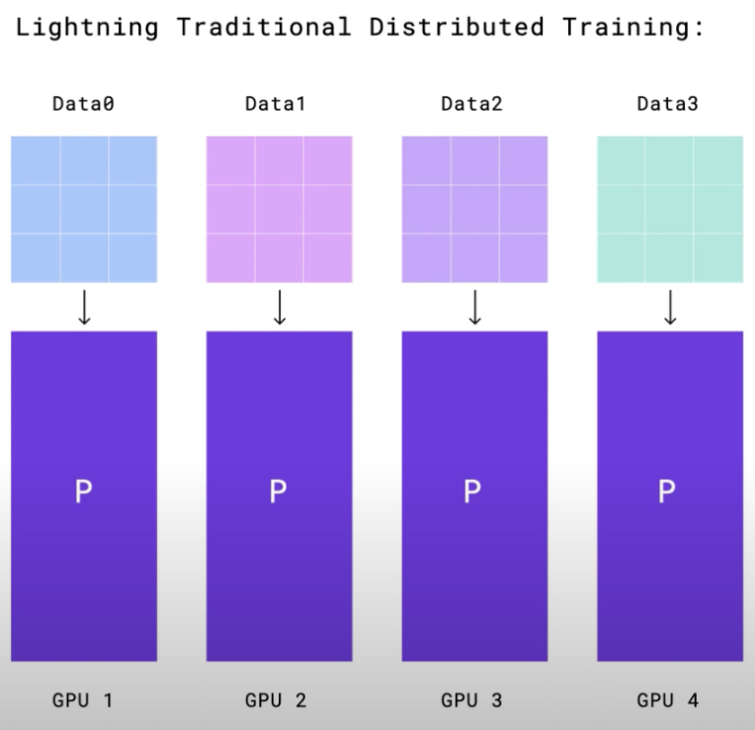
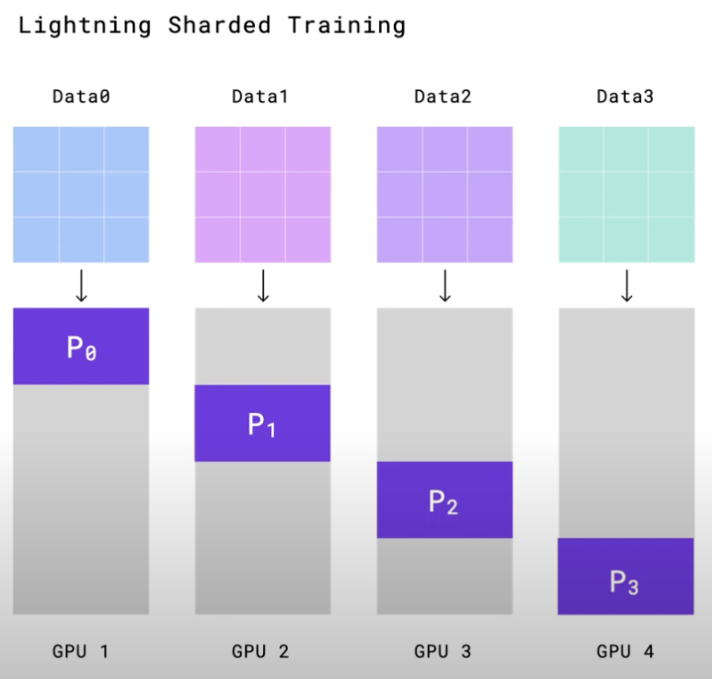
Solution Diagram / Architecture
Notes:
Reference - NVIDIA GTC '21: Half The Memory with Zero Code Changes: Sharded Training with Pytorch Lightning Youtube (https://www.youtube.com/watch?v=w_CKzh5C1K4&t=805s)

Slide 9
Implementation Details
Models - Huggingface library¹
Pytorch Lightning² - Lightweight pytorch wrapper that abstracts boilerplate Deep Learning code
Readability, Robustness, Hardware agnostic
Training Strategy - distributed data parallelism and sharded training
Training Hardware - 1-2 Nvidia RTX8000 GPUs on NYU HPC Greene Cluster
Visualization and Metrics Analysis - Matplotlib, Numpy and Pandas
1 https://huggingface.co/docs/transformers/model_doc/t5
2 https://www.pytorchlightning.ai/

Slide 10
Experimental Design Flow
Minimum loss (to see how well the model converged)
Total training time
GPU utilization
GPU temperature (since high temperatures can damage hardware and reduce their lifespan)
Visualizing scaling efficiency
Plotting potential Pareto Curves

Slide 11
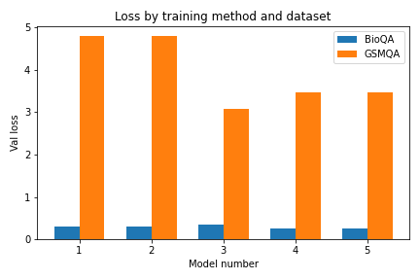
Validation Loss
For the BioQA dataset, we get relatively consistent values of loss for all configurations, with an increase for model 3 which is to be expected given we’re working with lower precision
Surprisingly, we see the opposite of this for the GSM dataset

Slide 12
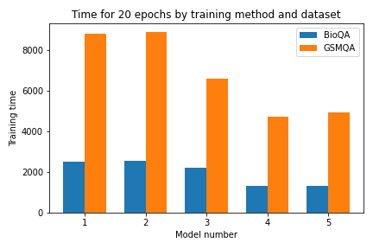
Training Time
We observe similar trends across both datasets
Training with lower precision was significantly faster
Taking advantage of 2 GPUs (4, 5) also helped speed up performance

Slide 13
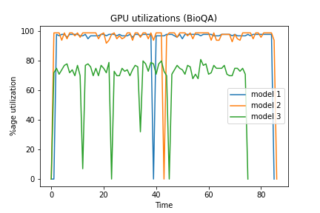
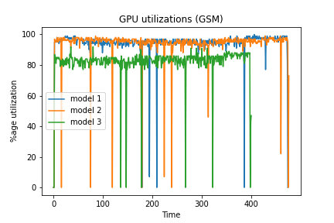
GPU Utilization
Performing an identical task on 2 GPUs reduced the average utilization on each GPU -> we can increase the model size and effective batch size in search of better performance
Reducing FP precision also reduced the GPU utilization

Slide 14
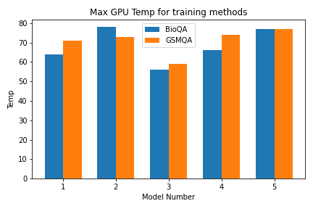
Max GPU temperature
We observe similar trends across both datasets
Training with lower precision led to lower temps

Slide 15
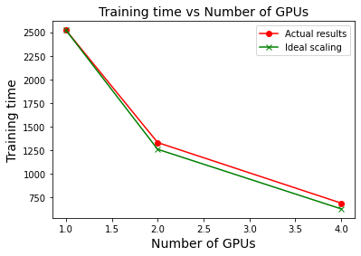
Scaling Performance
On the BioQA dataset we observed almost ideal scaling
The difference between actual and ideal will increase as model size and batch size increases

Slide 16
Training an even larger model
Throughout our experiments, we were still able to fine-tune a t5-base model (220M parameters) on a single GPU, albeit slowly
The ability of distributed training is better exhibited by training models that are too big to run on a single GPU
To this end, we fine-tuned the t5-large model (770M params) on the BioQA dataset using model parallelism
This failed when attempted on a single GPU

Slide 17
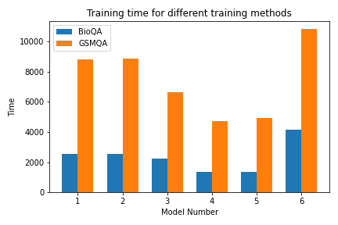
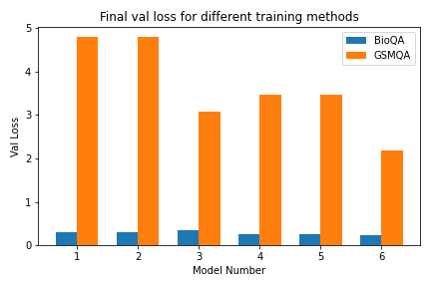
T5-large results
By training a larger model - we were able to converge to a lower loss in the same number of epochs
However, this comes at the expense of increased training time

Slide 18
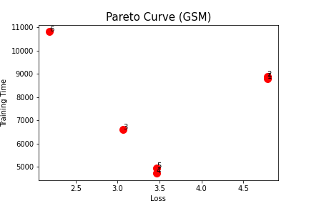
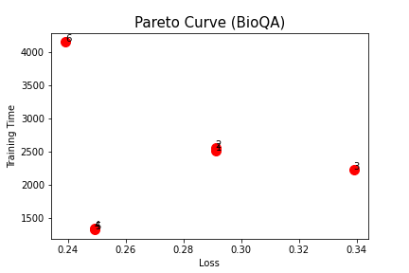
Pareto Curves
For BioQA, quite clear that it is optimal to use some form of distributed training and reducing the FP precision is very detrimental
In GSM, reducing FP precision can also help improve training time and val loss

Slide 19
Conclusion
Optimization | Description | Results (Speed) | Results (Loss)
Increasing the number of processes for data loading | Changing num_workers to 2 from 1 | N/A | Dependent on type and structure of dataset, no real change observed here
Lower precision training | Changing all the values from FP32 to FP16 | 1.3x faster for GSM 1.15x faster for BioQA | 1.15x worse loss for BioQA Lower loss for GSM
Data Parallelism | Splitting the mini-batch across different GPUs | 1.85x faster for GSM and BioQA | Lower losses for both of them too
Sharded | Splitting the model across different GPUs | 1.8x faster for GSM 1.9x faster for BioQA | Lower losses for both of them too

Slide 20
Github Repo Link
https://github.com/gcharvi31/t5-tuning

